Slide 1


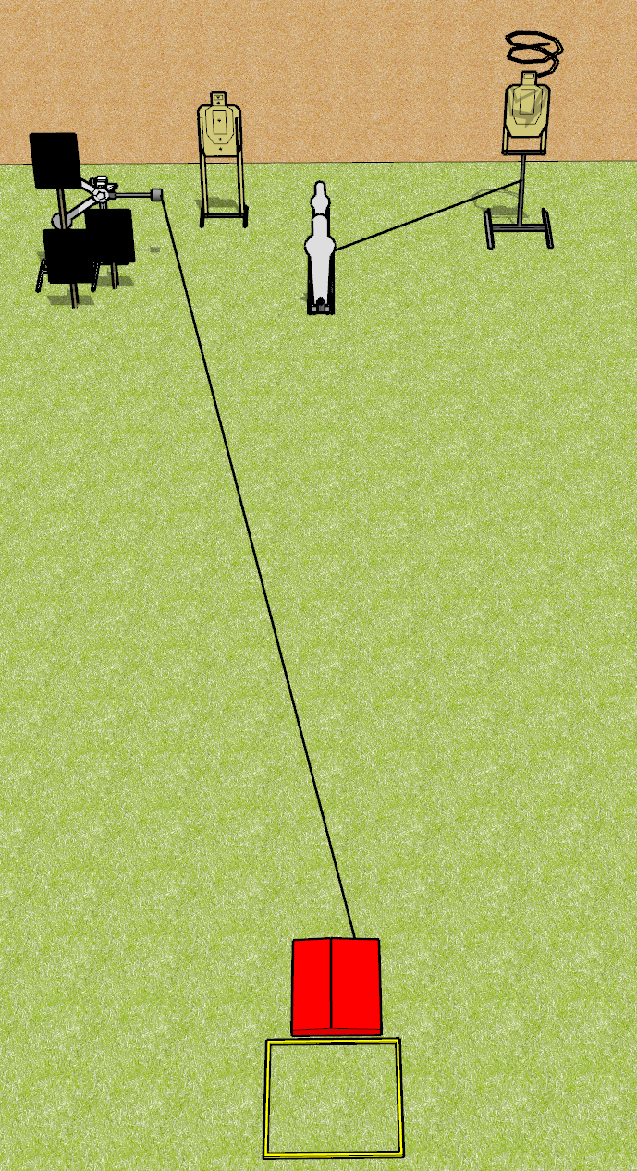
 | Dothan Gun Club – USPSA Match It Goes Away Course Designer : Drew Coleman
Round Count 8 rounds 2 USPSA 1 pepper popper, 1 mini popper, 2 plates
Equipment List Shooting box Stomp pad Red stitch target + activator + hard cover Drop turner + activator

Slide 2
It Goes Away
Written Stage Briefing
Scoring: Comstock
Rounds: 8
Targets: 2 USPSA and 4 steel
Handgun start position: heels touching the rear of the shooting box, wrists below belt. Handgun is loaded and holstered.
PCC start position: heels touching the rear of the shooting box, stock on belt. Loaded carbine is held with both hands, safety on.
Stage Procedure: on the audible start signal, engage targets as they become available from within the shooting area. The swinger is activated by the stomp pad and remains visible at rest. The stomp pad is part of the shooting area. The drop turner is activated by P1 and is a disappearing target.

